Slide 1
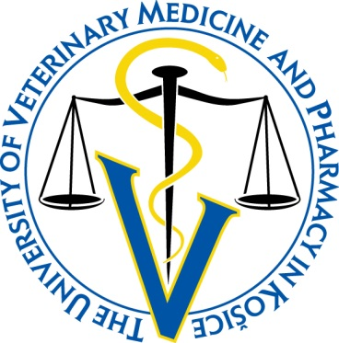
Evaluation of hepatocytes number and diameter
of central vein after bendicoarb exposure
Danko, J.¹, Petrovova, E.¹, Massanyi, P.², Lukac, N.², Stawarz, R.³
¹University of Veterinary Medicine and Pharmacy in Kosice, SLOVAKIA
²Slovak University of Agriculture in Nitra, SLOVAKIA
³Pedagogical University of Krakow, POLAND

Slide 3
MORPHOMETRIC METHODS AND ANALYSIS
Forgacs, Zs, Massanyi, P. Lukac, N, Somosy, Z: Reproductive toxicology of nickel – Review. JOURNAL OF ENVIRONMENTAL SCIENCE AND HEALTH PART A-TOXIC/HAZARDOUS SUBSTANCES & ENVIRONMENTAL ENGINEERING, 2012, 47, 9, 1249-1260.
Massanyi, P, Lukac, N, Zemanova, J, Makarevich, AV, Chrenek, P, Cigankova, V, Flesarova, S, Toman, R, Forgacs, Z, Somosy, Z, Lazor, P: Effect of nickel administration in vivo on the testicular structure in mice. ACTA VETERINARIA BRNO, 2007, 76, 2, 223-229.
Massanyi, P, Lukac, N, Uhrin, V, Toman, R, Pivko, J, Rafay, J, Forgacs, Zs, Somosy, Z: Female reproductive toxicology of cadmium. ACTA BIOLOGICA HUNGARICA, 2007, 58, 3, 287-299.
Massanyi, P, Lukac, N, Slivkova, J, Makarevich, AV, Chrenek, P, Forgacs, Zs, Zakrewski, M, Stawarz, R, Toman, R, Lazor, P, Flesarova, S: Mercury induced alterations in rat kidney and testes in vivo. JOURNAL OF ENVIRONMENTAL SCIENCE AND HEALTH PART A-TOXIC/HAZARDOUS SUBSTANCES & ENVIRONMENTAL ENGINEERING, 2007, 42, 7, 865-870.
Massanyi, P, Lukac, N, Makarevich, AV, Chrenek, P, Forgacs, Zs, Zakrewski, M, Stawarz, R, Toman, R, Lazor, P, Flesarova, S: Lead induced alterations in rat kidney and testes in vivo. JOURNAL OF ENVIRONMENTAL SCIENCE AND HEALTH PART A-TOXIC/HAZARDOUS SUBSTANCES & ENVIRONMENTAL ENGINEERING, 2007, 42, 5, 671-676.

Slide 4
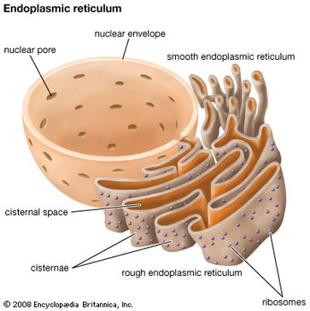
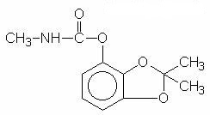
Bendiocarb is degraded in the liver, which has a major role in the biotransformation and excretion of carbamate pesticides from the body
Reactions of detoxication take place in hepatocytes by the enzymatic system situated in the endoplasmic reticulum, and bendiocarb is excreted as a sulphate and β–glucuronide conjugates of the phenol derivatives
90% of an oral bendiocarb dose is excreted in the urine, 1 – 3% in expired air, and 3 – 8% in the feces. Excretion is completed within 24 hours

Slide 5
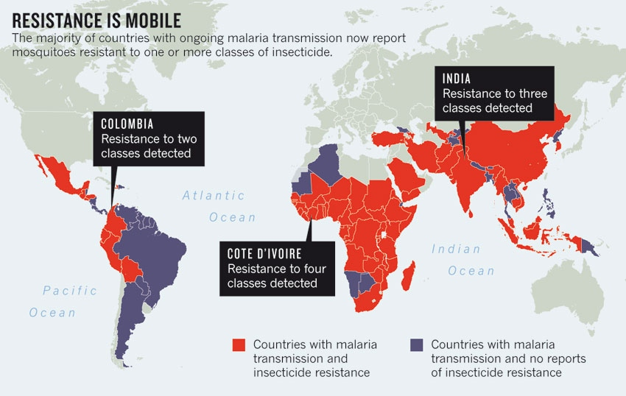
Field trials with the carbamates propoxur and bendiocarb for indoor residual spraying treatment have been very effective against pyrethroid resistant malaria vectors.
Over the past few years, there was an increasing interest in testing these insecticides for public health purposes as alternatives to pyrethroids
Maxmen, A., 2012: Malaria surge feared. Nature

Slide 6
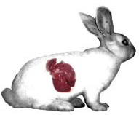
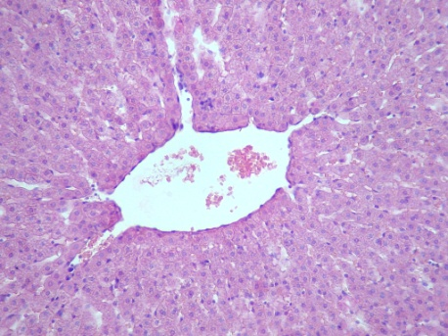
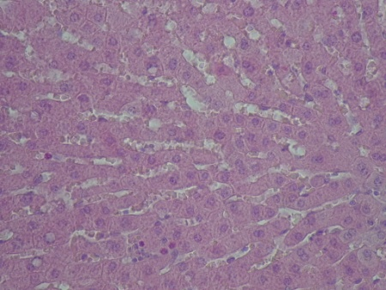
Aim of the study
In order to increase using of bendiocarb against vectors of malaria, thus it is important to examine every potential aspect of its toxicology.
The lack of information at all levels may be one of the most important causative factors of chemical intoxication in developing countries.
At present, several studies of bendiocarb effect with rabbit as an animal model have been published.
We can continue with results, particularly to organs which have a key role to biotransformation and excretion of bendiocarb.
The aim of our study was to observe the morphometric alterations of the rabbit liver tissue treated with bendiocarb, mostly hepatocytes number and diameter of the central vein

Slide 7
Material and Methods
We used 56 adult rabbits (age = 84 days) of breed HY+, 28 males and 28 females, and with average weight 2500 g
Animals were kept in cages at standard conditions (temperature 15 – 21°C, 12 hour light period and relative humidity of 45%)
Groups of animals (control, D10, D20, D30 of administration), and each group comprised 14 animals
Animals in control group were not treated and they were killed at D30 from the beginning of the experimental work.
Rabbits in all experimental groups received bendiocarb (96% Bendiocarb, Bayer, Germany) per os in a dose 5 mg/kg per day and after D11 in a same dose per 48 hours
Acute oral toxicity of bendiocarb (rabbit) 35 – 40 mg/kg of the body weight

Slide 8
Experimental animals were killed by thiopental (Thiopental Valeant 1 g, Czech Republic; 100 mg/kg of body weight) intravenous administration at D10, 20 and 30 after bendiocarb treatment
Liver samples from all animals were dissected immediately after the animals were killed and fixed in 10% neutral formalin. Paraffin sections (7 µm thick) were stained for routine histological study using haematoxylin and eosin for morphometric evaluation under light microscope (FL – 800).
All morphometric variables were obtained using a light microscope with two objectives 20x and 40x, and photo–equipment (Olympus Provis AX) to prepare images for morphometric analysis

Slide 9
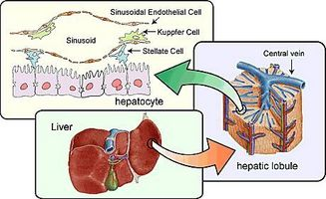
Total number of hepatocytes
More than 300 microscopic fields randomly selected were examined.
The sampling procedure began with a random selection of 5 – 6 fields of the liver parenchyma from each animal of the control and experimental groups
A 16–points square lattice was used to quantitative evaluation of hepatocytes (the total number of hepatocytes).
The grid was overlaid onto each microscopic field (87 296 µm²)

Slide 10
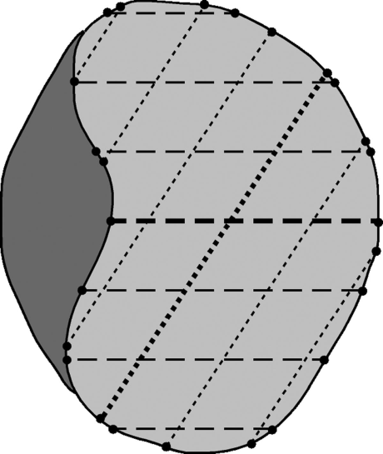
Analysis of the central vein diameter
Central veins were analyzed under 40× magnification
The morphometric analysis of the vessel along the selected analysis path, is based on the quantification of the cross–sectional areas and diameters for each cross–sectional section.
For each in–plane direction, the maximum, distance between two boundary points parallel to that direction is determined.
The minimum, average, and maximum vessel diameters are then computed as the minimum, average, and maximum values, respectively, of all of these distances.
For the evaluation were used of 165 measurements
Boskamp, T. et al., 2004: New vessel analysis tool for morphometric quantification and visualization of vessels in CT and MR Imaging data sets. RadioGraphics
Diameter measurement in a cross section of a vessel with plaque (dark gray area). Light gray area the lumen. For each direction, the maximum distance parallel to that direction between two lumen boundary points defines a “directional diameter.” (The bold lines represent the directional diameters for two single directions.) The minimum, average, and maximum over all of the directional diameters yield the minimum, average, and maximum diameters of the vessel lumen, respectively

Slide 11
Statistics
display of the microscopic fields Adobe Photoshop 7.0
measurement Image Acquisition Software getIT
(Olympus Soft Imaging Solution GmbH)
statistical analyses GraphPad Prism 5.0
The data were analyzed and expressed as means ± SD (standard deviation of the mean), the minimum, average, and maximum values.
Student´s t–Test was used to compare between the data of the control and those of treatments
Level of statistical significance p-value; p ≤ 0.05

Slide 12
Results
Total number and size of hepatocytes
Significantly higher number of the liver cells was observed at D10 of bendiocarb treatment (26.0 ± 6.5/100 µm³) in comparison with the control group (19.5 ± 2.0/100 µm³)
The number of hepatocytes in the rest of treatment groups was unchanged to control group
Changes of the size of hepatocytes were observed at D10 and 20 of the pesticide treatment.
The size of hepatocytes was significantly decreased at D10 (14.2 ±2.6 µm) but the hepatocyte size was increased at D20 (16.5 ± 2.3 µm) against the size of hepatocytes in the control group (15.5 ± 2.1 µm)
Diameter of the central vein
The diameter of central veins ranged from 58.3 to 160.5 µm, and the mean diameter was lower at D10 (113.9 ± 25.2 µm), but not significantly compared with control (118.2 ± 22.3 µm)

Slide 14
 | Day | x | SD ª | Minimum | Maximum
Number of liver cells (100 µm³) | control | 19.55 | 1.95 | 17.35 | 24.22
 | 10 | 26.34^{b} | 6.46 | 16.69 | 43.69
 | 20 | 20.67 | 2.61 | 14.57 | 24.55
 | 30 | 20.94^{b} | 2.14 | 17.18 | 25.20
Size of liver cells (µm) | control | 15.50 | 2.12 | 11.50 | 20.30
 | 10 | 14.20^{b} | 2.59 | 9.00 | 19.33
 | 20 | 16.50^{b} | 2.29 | 10.66 | 20.33
 | 30 | 15.50 | 3.50 | 9.83 | 23.50
Diameter of v. centralis (µm) | control | 118.23 | 22.36 | 58.34 | 158.78
 | 10 | 113.90 | 25.17 | 62.15 | 147.95
 | 20 | 118.71 | 33.21 | 63.19 | 155.87
 | 30 | 121.08 | 35.74 | 67.93 | 160.46

Slide 15
Conclusion
In view of the data of the present study, it can be concluded that bendiocarb has moderately toxic effect on the rabbit liver tissue, regardless of gender.
After the short–term bendiocarb treatment the regeneration behavior of the liver was observed in relation to binucleated hepatocytes, the higher number of liver cells and their decreased size
Long–term treatment causes vacuolization and dilatation of hepatocytes, dilatation of sinusoids between hepatocytes and focal infiltration of inflammatory cells.
Presence of the lipid vacuoles both in the liver parenchyma and inner of the hepatocytes could lead to the liver steatosis after prolonged exposure
Our results confirm (according to some previous studies) a negative effect of bendiocarb on animal health

Slide 16
MORPHOMETRIC METHODS AND ANALYSIS
BENDIOCARBAMATE – related results
Krockova, J, Massanyi, P, Toman, R, Danko, J, Roychoudhury, S: In vivo and in vitro effect of bendiocarb on rabbit testicular structure and spermatozoa motility. JOURNAL OF ENVIRONMENTAL SCIENCE AND HEALTH PART A-TOXIC/HAZARDOUS SUBSTANCES & ENVIRONMENTAL ENGINEERING, 2012, 47, 9, 1301-1311.
Petrovova, E, Massanyi, P, Capcarova, M, Zivcak, J, Stodola, L.: Structural alterations in the rabbit spleen after bendiocarb administration. JOURNAL OF ENVIRONMENTAL SCIENCE AND HEALTH PART B - PESTICIDES, FOOD CONTAMINANTS, AND AGRICULTURAL WASTES, 2011, 46, 788-792.
Petrovova, E, Mazensky, D, Luptakova, L, Holovska, K, Spalekova, E, Massanyi, P, Haladova, E, Toth, T.: Alterations in the rabbit lymphoid tissue after bendiocarb administration. JOURNAL OF ENVIRONMENTAL SCIENCE AND HEALTH PART B - PESTICIDES, FOOD CONTAMINANTS, AND AGRICULTURAL WASTES, 2010, 45, 7, 719-728.
Petrovova, E, Mazensky, D, Vdoviakova, K, Luptakova, L, Massanyi, P, Smrco, P: Effect of bendiocarb on development of chick embryo. JOURNAL OF APPLIED TOXICOLOGY, 2010, 17, 5, 397-401.
Flesarova, S, Lukac, N, Danko, J, Massanyi, P: Bendiocarbamate induced structural alterations in rabbit thymus after experimental peroral administration. JOURNAL OF ENVIRONMENTAL SCIENCE AND HEALTH PART B-PESTICIDES, FOOD CONTAMINANTS, AND AGRICULTURAL WASTE, 2007, 42, 3, 329-334

Slide 17
Košice
Slovakia
THANK YOU FOR YOUR KIND ATTENTION

