Slide 1
DEVELOPING QUANTITATIVE METHODS IN COMMUNITY ECOLOGY: PREDICTING SPECIES ABUNDANCES FROM QUALITATIVE WEB INTERACTION DATA
Hugo Fort
Complex Systems Group
Department of Physics
Universidad de la República, Montevideo, Uruguay

Slide 2
1. GOALS
Question 1: Quantitative predictions for what?
Quantitative predictions of biodiversity of human-impacted ecological communities are crucial for their management.
To assess the impact of management decisions on communities, we need to go beyond qualitative analysis of general and abstract communities and be able to make quantitative predictions for real specific communities in nature.
Question 2: Why pollination?
Pollination is a really important ecosystem service
Nearly 85% of all flowering plants are pollinated by animals
35% of global crop production depends on pollinators
In spite of the great progress in describing the interactions between plants and their pollinators, the capability of making quantitative predictions is still in its infancy.

Slide 3
These quantitative predictions are currently limited by a lack of
estimation of species abundances
and
2) methodological tools to deal with the complexity of mutualisms in general and pollination in particular.
A panel convened by the NSF in 2006 to discuss the “frontiers of ecology”, and to make recommendations for research priority areas in population and community ecology, stated that ecology will become more quantitative and predictive if research is focused on the strength of interactions between species.
Therefore my goal is to introduce a quantitative method, based on the qualitative information we have on the interactions between pollinator species to overcome the above limitations 1) & 2).

Slide 4
2. From a bi-partite mutualistic network to a uni-partite competition system
The idea is to reduce the bi-partite mutualistic network into a uni-partite competition network.
Variables we want
to compute are pollinator
abundances N_{i} (i=1,2,…,n)
Resource
for which
pollinators
compete

Slide 5
2.1 Lotka-Volterra Competition Equations
Lotka-Volterra competition equation for n species:
Firstly I will show you an ideal procedure to experimentally estimate the coefficients of the LV competition equations.
Unfortunately this procedure is beyond current capabilities. So, secondly, I will propose a possible way to estimate the coefficients using the available qualitative information from field studies.

Slide 6
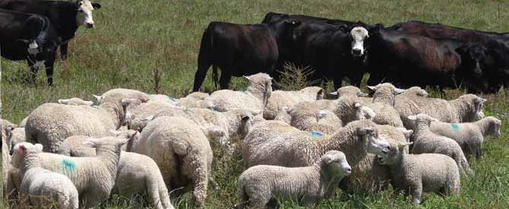
2.2 Estimating the parameters of LV Competition Equations: ideal procedure
An illustrative example is livestock production:
A typical situation,
two species
competing for
one resource (grass):

Slide 7
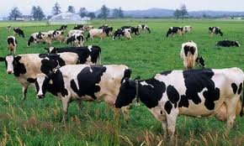
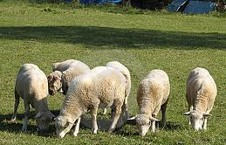

Slide 9
2.3 Estimating the parameters: A realistic procedure for many species
Coming back to the L-V competition model for n species:
In the case of pollinator communities, the number of species n is typically of the order of 50, competing by resources that are flowers to extract nectar.
For n = 50, to estimate the model parameters, we should perform 50 x 50 = 2,500 experiments!
Therefore this is not feasible. So we have to rely on field studies.

Slide 10
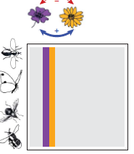
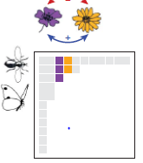
In turns out that for the majority of plant-pollinator networks the available information is in the form of QUALITATIVE (BINARY) interaction matrices or adjacency matrices g_{ap} given by:
Insects/Flowers | Diplopterys pubipetala | Byrsonima gardnerana | Banisteriopsis muricata | Heteropterys sp1 | Heteropterys sp2 | Dicella bracteosa | Carolus chasei | Stigmaphyllon paralias | Banisteriopsis stellaris | Banisteriopsis schizoptera | Stigmaphyllon auriculatum | Stigmaphyllon ciliatum | Janusia anisandra
Centris aenea | 1 | 1 | 1 | 1 | 1 | 1 | 1 | 1 | 1 | 1 | 1 | 1 | 1
Centris fuscata | 1 | 1 | 1 | 1 | 1 | 1 | 1 | 1 | 1 | 1 | 1 | 1 | 1
Centris caxiensis | 1 | 1 | 1 | 1 | 1 | 1 | 1 | 0 | 1 | 1 | 1 | 0 | 0
Centris tarsata | 1 | 1 | 1 | 1 | 1 | 1 | 1 | 0 | 1 | 1 | 0 | 0 | 1
Centris flavifrons | 1 | 1 | 1 | 1 | 0 | 1 | 0 | 0 | 0 | 0 | 1 | 1 | 0
Centris trigonoides | 1 | 0 | 1 | 1 | 1 | 0 | 0 | 0 | 0 | 0 | 0 | 0 | 0
Centris obsoleta | 0 | 0 | 1 | 0 | 0 | 0 | 0 | 0 | 0 | 0 | 0 | 0 | 0
Epicharis sp2 | 1 | 0 | 1 | 1 | 1 | 0 | 0 | 0 | 0 | 0 | 0 | 0 | 0
Apis mellifera | 1 | 1 | 1 | 0 | 1 | 0 | 0 | 0 | 0 | 0 | 0 | 0 | 0
Centris sp3 | 1 | 0 | 0 | 0 | 0 | 0 | 0 | 0 | 0 | 0 | 0 | 0 | 0
Centris sp1 | 0 | 0 | 1 | 0 | 0 | 0 | 0 | 0 | 0 | 0 | 0 | 0 | 0
Xylocopa sp | 0 | 0 | 1 | 1 | 0 | 0 | 0 | 0 | 0 | 0 | 0 | 0 | 0
Xylocopa grisescens | 0 | 0 | 1 | 0 | 0 | 0 | 0 | 0 | 0 | 0 | 0 | 0 | 0
For each entry (row = i, column = j):
0 means pollinator species i and plant species j don’t interact
1 means pollinator species i and plant species j do interact

Slide 11
An important quantity to separate specialist species from generalist species: the degree D
Insects/Flowers | Diplopterys pubipetala | Byrsonima gardnerana | Banisteriopsis muricata | Heteropterys sp1 | Heteropterys sp2 | Dicella bracteosa | Carolus chasei | Stigmaphyllon paralias | Banisteriopsis stellaris | Banisteriopsis schizoptera | Stigmaphyllon auriculatum | Stigmaphyllon ciliatum | Janusia anisandra
Centris aenea | 1 | 1 | 1 | 1 | 1 | 1 | 1 | 1 | 1 | 1 | 1 | 1 | 1
Centris fuscata | 1 | 1 | 1 | 1 | 1 | 1 | 1 | 1 | 1 | 1 | 1 | 1 | 1
Centris caxiensis | 1 | 1 | 1 | 1 | 1 | 1 | 1 | 0 | 1 | 1 | 1 | 0 | 0
Centris tarsata | 1 | 1 | 1 | 1 | 1 | 1 | 1 | 0 | 1 | 1 | 0 | 0 | 1
Centris flavifrons | 1 | 1 | 1 | 1 | 0 | 1 | 0 | 0 | 0 | 0 | 1 | 1 | 0
Centris trigonoides | 1 | 0 | 1 | 1 | 1 | 0 | 0 | 0 | 0 | 0 | 0 | 0 | 0
Centris obsoleta | 0 | 0 | 1 | 0 | 0 | 0 | 0 | 0 | 0 | 0 | 0 | 0 | 0
Epicharis sp2 | 1 | 0 | 1 | 1 | 1 | 0 | 0 | 0 | 0 | 0 | 0 | 0 | 0
Apis mellifera | 1 | 1 | 1 | 0 | 1 | 0 | 0 | 0 | 0 | 0 | 0 | 0 | 0
Centris sp3 | 1 | 0 | 0 | 0 | 0 | 0 | 0 | 0 | 0 | 0 | 0 | 0 | 0
Centris sp1 | 0 | 0 | 1 | 0 | 0 | 0 | 0 | 0 | 0 | 0 | 0 | 0 | 0
Xylocopa sp | 0 | 0 | 1 | 1 | 0 | 0 | 0 | 0 | 0 | 0 | 0 | 0 | 0
Xylocopa grisescens | 0 | 0 | 1 | 0 | 0 | 0 | 0 | 0 | 0 | 0 | 0 | 0 | 0
Insects/Flowers | Diplopterys pubipetala | Byrsonima gardnerana | Banisteriopsis muricata | Heteropterys sp1 | Heteropterys sp2 | Dicella bracteosa | Carolus chasei | Stigmaphyllon paralias | Banisteriopsis stellaris | Banisteriopsis schizoptera | Stigmaphyllon auriculatum | Stigmaphyllon ciliatum | Janusia anisandra
Centris aenea | 1 | 1 | 1 | 1 | 1 | 1 | 1 | 1 | 1 | 1 | 1 | 1 | 1
Centris fuscata | 1 | 1 | 1 | 1 | 1 | 1 | 1 | 1 | 1 | 1 | 1 | 1 | 1
Centris caxiensis | 1 | 1 | 1 | 1 | 1 | 1 | 1 | 0 | 1 | 1 | 1 | 0 | 0
Centris tarsata | 1 | 1 | 1 | 1 | 1 | 1 | 1 | 0 | 1 | 1 | 0 | 0 | 1
Centris flavifrons | 1 | 1 | 1 | 1 | 0 | 1 | 0 | 0 | 0 | 0 | 1 | 1 | 0
Centris trigonoides | 1 | 0 | 1 | 1 | 1 | 0 | 0 | 0 | 0 | 0 | 0 | 0 | 0
Centris obsoleta | 0 | 0 | 1 | 0 | 0 | 0 | 0 | 0 | 0 | 0 | 0 | 0 | 0
Epicharis sp2 | 1 | 0 | 1 | 1 | 1 | 0 | 0 | 0 | 0 | 0 | 0 | 0 | 0
Apis mellifera | 1 | 1 | 1 | 0 | 1 | 0 | 0 | 0 | 0 | 0 | 0 | 0 | 0
Centris sp3 | 1 | 0 | 0 | 0 | 0 | 0 | 0 | 0 | 0 | 0 | 0 | 0 | 0
Centris sp1 | 0 | 0 | 1 | 0 | 0 | 0 | 0 | 0 | 0 | 0 | 0 | 0 | 0
Xylocopa sp | 0 | 0 | 1 | 1 | 0 | 0 | 0 | 0 | 0 | 0 | 0 | 0 | 0
Xylocopa grisescens | 0 | 0 | 1 | 0 | 0 | 0 | 0 | 0 | 0 | 0 | 0 | 0 | 0
Insects/Flowers | Diplopterys pubipetala | Byrsonima gardnerana | Banisteriopsis muricata | Heteropterys sp1 | Heteropterys sp2 | Dicella bracteosa | Carolus chasei | Stigmaphyllon paralias | Banisteriopsis stellaris | Banisteriopsis schizoptera | Stigmaphyllon auriculatum | Stigmaphyllon ciliatum | Janusia anisandra
Centris aenea | 1 | 1 | 1 | 1 | 1 | 1 | 1 | 1 | 1 | 1 | 1 | 1 | 1
Centris fuscata | 1 | 1 | 1 | 1 | 1 | 1 | 1 | 1 | 1 | 1 | 1 | 1 | 1
Centris caxiensis | 1 | 1 | 1 | 1 | 1 | 1 | 1 | 0 | 1 | 1 | 1 | 0 | 0
Centris tarsata | 1 | 1 | 1 | 1 | 1 | 1 | 1 | 0 | 1 | 1 | 0 | 0 | 1
Centris flavifrons | 1 | 1 | 1 | 1 | 0 | 1 | 0 | 0 | 0 | 0 | 1 | 1 | 0
Centris trigonoides | 1 | 0 | 1 | 1 | 1 | 0 | 0 | 0 | 0 | 0 | 0 | 0 | 0
Centris obsoleta | 0 | 0 | 1 | 0 | 0 | 0 | 0 | 0 | 0 | 0 | 0 | 0 | 0
Epicharis sp2 | 1 | 0 | 1 | 1 | 1 | 0 | 0 | 0 | 0 | 0 | 0 | 0 | 0
Apis mellifera | 1 | 1 | 1 | 0 | 1 | 0 | 0 | 0 | 0 | 0 | 0 | 0 | 0
Centris sp3 | 1 | 0 | 0 | 0 | 0 | 0 | 0 | 0 | 0 | 0 | 0 | 0 | 0
Centris sp1 | 0 | 0 | 1 | 0 | 0 | 0 | 0 | 0 | 0 | 0 | 0 | 0 | 0
Xylocopa sp | 0 | 0 | 1 | 1 | 0 | 0 | 0 | 0 | 0 | 0 | 0 | 0 | 0
Xylocopa grisescens | 0 | 0 | 1 | 0 | 0 | 0 | 0 | 0 | 0 | 0 | 0 | 0 | 0
Summing across rows (over plant species)
D
13
13
10
10
7
4
1
4
4
1
1
2
1
That is, pollinator species Centris aenea interacts with all the 13 species of plants and then it has D = 13.
D
13
13
10
10
7
4
1
4
4
1
1
2
1
D
13
13
10
10
7
4
1
4
4
1
1
2
1
D
13
Specialist pollinator species: low degree D (they interact with few plant species).
Specialist pollinator species: low degree D (they interact with few plant species).
Generalist pollinator species: high degree D (they interact with many plant species).

Slide 12
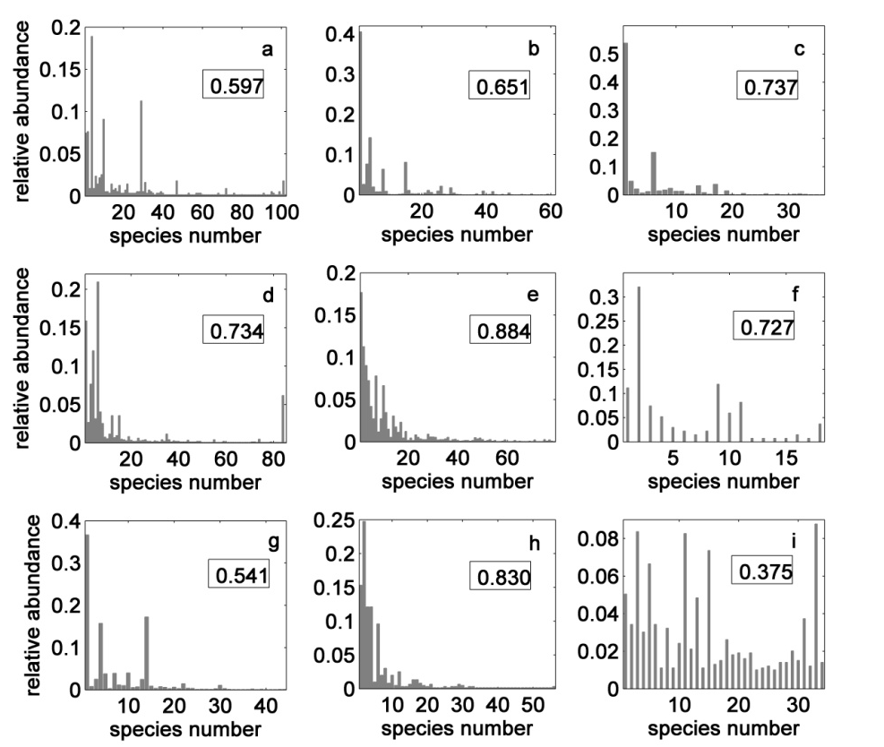
I proposed this way to compute the parameters K_{i} & α_{ik} :
First, since it was empirically observed a correlation between D and abundance
Abundant
species tend
to be
generalists
generalists
high D
specialists
low D
So I take K_{i} as proportional to the species degree D_{i}, i.e.
K_{i} = k x D_{i}.

Slide 13
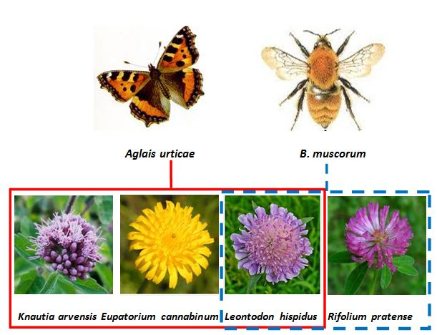
2. For the competition coefficients, I assume the principle of niche overlapping: the greater the overlap in resource use for two species, the greater their competition and therefore I will take α_{ik} ∝ to the Jaccard similarity index :
So the overlap between these pair of
species is ONE plant species.

Slide 14
3.THEORY vs EMPIRICAL DATA
The data set of plant-pollinator interactions comprises a total of 38 mutualistic networks (Rezende 2007, NCEAS 2014), spanning a broad geographic range from arctic to tropical and temperate and Mediterranean. The list of networks, including their richness S_{A} and corresponding locations is:
Number | Code name | S_{A} | Quantitative matrix | Locality
1 | ARR1 | 101 | NO | Cordón del Cepo, Chile
2 | ARR2 | 64 | NO | Cordón del Cepo, Chile
3 | ARR3 | 25 | NO | Cordón del Cepo, Chile
4 | BAHE | 102 | YES | Central New Brunswick, Canada
5 | BEZE | 13 | YES | Pernambuco State, Brazil
6 | CLLO | 275 | NO | Pikes Peak, Colorado, USA
7 | DIHI | 61 | YES | Hickling, Norfolk, UK
8 | DISH | 36 | YES | Shelfanger, Norfolk, UK
9 | DUPO | 38 | NO | Tenerife, Canary Islands
10 | EOL | 118 | NO | Latnjajaure, Abisko, Sweden
11 | EOLZ | 76 | NO | Zackenberg
12 | ESKI | 13 | NO | Mauritius Island
13 | HERR | 179 | NO | Doñana Nat. Park, Spain
14 | HOCK | 81 | NO | Hazen Camp, Ellesmere Island, Canada
15 | INPK | 85 | YES | Snowy Mountains, Australia

Slide 15
16 | KEVN | 27 | NO | Hazen Camp, Ellesmere Island, Canada
17 | KT90 | 679 | YES | Ashu, Kyoto, Japan
18 | MED1 | 45 | NO | Laguna Diamante, Mendoza, Argentina
19 | MED2 | 72 | NO | Rio Blanco, Mendoza, Argentina
20 | MEMM | 79 | YES | Bristol, England
21 | MOMA | 18 | YES | Melville Island, Canada
22 | MOTT | 44 | YES | North Carolina, USA
23 | MULL | 54 | NO | Galapagos
24 | OFLO | 28 | NO | Flores, Açores
25 | OFST | 42 | NO | Hestehaven, Denmark
26 | OLAU | 55 | NO | Garajonay, Gomera, Spain
27 | OLLE | 56 | YES | KwaZulu-Natal region, South Africa
28 | PERC | 36 | NO | Jamaica
29 | PRAP | 60 | NO | Arthur's Pass, New Zealand
30 | PRCA | 139 | NO | Cass, New Zealand
31 | PRCG | 118 | NO | Craigieburn, New Zealand
32 | PTND | 666 | NO | Daphní, Athens, Greece
33 | RABR | 53 | NO | Guarico State, Venezuela
34 | RMRZ | 49 | NO | Canaima Nat. Park, Venezuela
35 | SCHM | 33 | YES | Brownfield, Illinois, USA
36 | SMAL | 34 | YES | Ottawa, Canada
37 | SMRA | 130 | NO | Chiloe, Chile
38 | VASI | 30 | YES | Llao Llao, Argentina

Slide 16
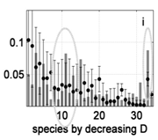
Pictorial comparison between empirical and theoretical relative
abundances for pollinator species (R.A.P.S.).
The ovals point entire sectors of the R.A.P.S. (ordered by decreasing D) departing from the neutral monotonic behavior that can be reproduced by the model.
INPK (d), MEMM (e) & SMAL (i)

Slide 17
Quantitative comparison between empirical and theoretical relative
abundances for pollinator species.
Indices
Shannon equitability index
Simpson-Gini index

Slide 18
Table Empirical and theoretical biodiversity metrics for plant-pollinator networks. For all the networks, except for the SMAL network, p-value < 0.01 and the correlation was significant.
Network code ^{(*)} | Richness S_{A}^{(*)} | Agreement emp. & theo. RAPS |  | Shannon's equitability |  | Simpson-Gini index
 |  | d_{emp-theo} | Pearson r_{emp-theo} | H_{emp} | H_{theo} | SG_{emp} | SG_{theo}
BAHE | 102 | 0.74 | 0.59 | 0.74 | 0.69 | 0.93 | 0.93
BEZE | 13 | 0.98 | 0.97 | 0.79 | 0.75 | 0.82 | 0.82
DIHI | 61 | 0.77 | 0.67 | 0.56 | 0.66 | 0.80 | 0.90
DISH | 36 | 0.78 | 0.78 | 0.53 | 0.76 | 0.68 | 0.90
INPK | 85 | 0.81 | 0.72 | 0.66 | 0.77 | 0.90 | 0.95
KT90 | 679 | 0.78 | 0.70 | 0.84 | 0.67 | 0.99 | 0.97
MEMM | 79 | 0.96 | 0.91 | 0.72 | 0.71 | 0.93 | 0.93
MOMA | 18 | 0.85 | 0.74 | 0.79 | 0.83 | 0.85 | 0.87
MOTT | 44 | 0.63 | 0.54 | 0.59 | 0.80 | 0.80 | 0.94
OLLE | 56 | 0.89 | 0.88 | 0.65 | 0.77 | 0.87 | 0.94
SCHE | 32 | 0.83 | 0.72 | 0.73 | 0.78 | 0.87 | 0.91
SMAL | 34 | 0.51 | 0.28 | 0.93 | 0.89 | 0.95 | 0.94
VASI | 30 | 0.81 | 0.79 | 0.58 | 0.80 | 0.78 | 0.91

Slide 19
Table Empirical and theoretical biodiversity metrics for plant-pollinator networks. For all the networks, except for the SMAL network, p-value < 0.01 and the correlation was significant.
Network code ^{(*)} | Richness S_{A}^{(*)} | Agreement emp. & theo. RAPS |  | Shannon's equitability |  | Simpson-Gini index
 |  | d_{emp-theo} | Pearson r_{emp-theo} | H_{emp} | H_{theo} | SG_{emp} | SG_{theo}
BAHE | 102 | 0.74 | 0.59 | 0.74 | 0.69 | 0.93 | 0.93
BEZE | 13 | 0.98 | 0.97 | 0.79 | 0.75 | 0.82 | 0.82
DIHI | 61 | 0.77 | 0.67 | 0.56 | 0.66 | 0.80 | 0.90
DISH | 36 | 0.78 | 0.78 | 0.53 | 0.76 | 0.68 | 0.90
INPK | 85 | 0.81 | 0.72 | 0.66 | 0.77 | 0.90 | 0.95
KT90 | 679 | 0.78 | 0.70 | 0.84 | 0.67 | 0.99 | 0.97
MEMM | 79 | 0.96 | 0.91 | 0.72 | 0.71 | 0.93 | 0.93
MOMA | 18 | 0.85 | 0.74 | 0.79 | 0.83 | 0.85 | 0.87
MOTT | 44 | 0.63 | 0.54 | 0.59 | 0.80 | 0.80 | 0.94
OLLE | 56 | 0.89 | 0.88 | 0.65 | 0.77 | 0.87 | 0.94
SCHE | 32 | 0.83 | 0.72 | 0.73 | 0.78 | 0.87 | 0.91
SMAL | 34 | 0.51 | 0.28 | 0.93 | 0.89 | 0.95 | 0.94
VASI | 30 | 0.81 | 0.79 | 0.58 | 0.80 | 0.78 | 0.91
Network code ^{(*)} | Richness S_{A}^{(*)} | Agreement emp. & theo. RAPS |  | Shannon's equitability |  | Simpson-Gini index
 |  | d_{emp-theo} | Pearson r_{emp-theo} | H_{emp} | H_{theo} | SG_{emp} | SG_{theo}
BAHE | 102 | 0.74 | 0.59 | 0.74 | 0.69 | 0.93 | 0.93
BEZE | 13 | 0.98 | 0.97 | 0.79 | 0.75 | 0.82 | 0.82
DIHI | 61 | 0.77 | 0.67 | 0.56 | 0.66 | 0.80 | 0.90
DISH | 36 | 0.78 | 0.78 | 0.53 | 0.76 | 0.68 | 0.90
INPK | 85 | 0.81 | 0.72 | 0.66 | 0.77 | 0.90 | 0.95
KT90 | 679 | 0.78 | 0.70 | 0.84 | 0.67 | 0.99 | 0.97
MEMM | 79 | 0.96 | 0.91 | 0.72 | 0.71 | 0.93 | 0.93
MOMA | 18 | 0.85 | 0.74 | 0.79 | 0.83 | 0.85 | 0.87
MOTT | 44 | 0.63 | 0.54 | 0.59 | 0.80 | 0.80 | 0.94
OLLE | 56 | 0.89 | 0.88 | 0.65 | 0.77 | 0.87 | 0.94
SCHE | 32 | 0.83 | 0.72 | 0.73 | 0.78 | 0.87 | 0.91
SMAL | 34 | 0.51 | 0.28 | 0.93 | 0.89 | 0.95 | 0.94
VASI | 30 | 0.81 | 0.79 | 0.58 | 0.80 | 0.78 | 0.91

Slide 20
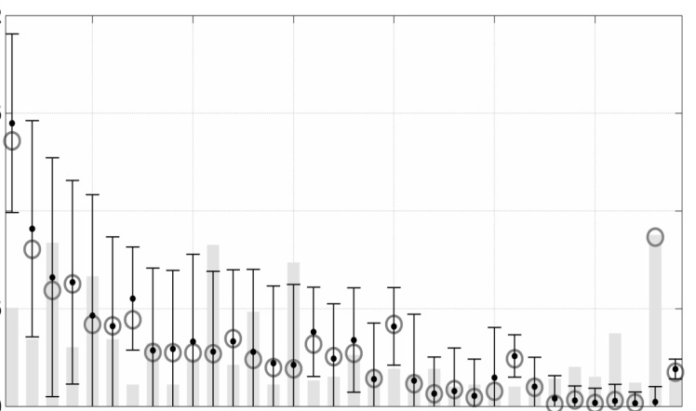
4. IMPROVMENTS
The proposed model can be improved by incorporating into it additional
empirical available information on species abundances.
For instance the model fails to reproduce few abnormal cases of abundant
specialist insect species (e.g. for the SMAL network).
A simple explanation for this mismatch is that the floral host, Nemopanthus mucronata, of this specialist, Dilophus caurinus, is highly abundant.
So a simple way to improve the model predictions is to incorporate this kind of known empirical facts.
The predictions of the model improve by changing the carrying capacity of Dilophus caurinus, from k_{Dc} = D_{Dc} = 1 to k_{Dc} = 5.
Besides the dramatic improvement for the predicted abundance of this particular species, the matching between theoretical and empirical abundances of all the other species also improves in some degree.

Slide 21
5. SUMMARY
I presented a simple method to make quantitative predictions on animal relative abundances from the qualitative and coarse (binary) information of their animal-plant interactions summarized in the adjacency matrices g_{ap}.
However the predicted RAPS are in general in quite good agreement with the
empirical ones for mutualistic networks spanning a broad geographic range.
2. The importance of interspecific competition between pollinator species is a controversial and unresolved issue, considerable circumstantial evidence suggests that competition between insects does occur, but a clear measure
of its impact on their species abundances is still lacking. This work contributed
to fill this gap by quantifying the effect of competition between pollinators.
3. Practical applications of this method to community management could be
to estimate quantitative effects of removing a species from a community or
to address the fate of populations of native organisms when foreign
species are introduced to ecosystems far beyond their home range.

Slide 22
Thank you

