Slide 1
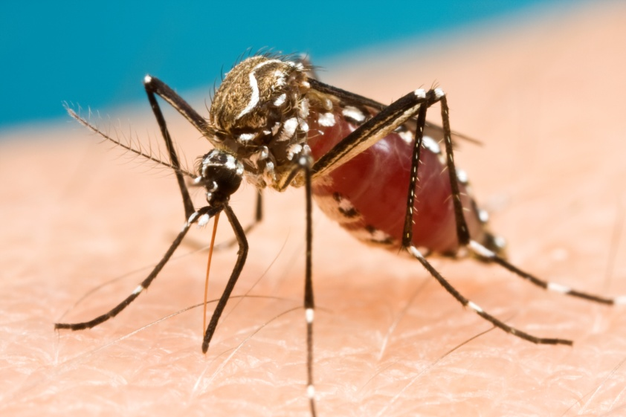
Developing Spatially Explicit Network Models for the Management of Disease Vectors in Ecological Systems
Brendan Trewin | PhD Candidate
Ecosystem services / Biosecurity flagship

Slide 2
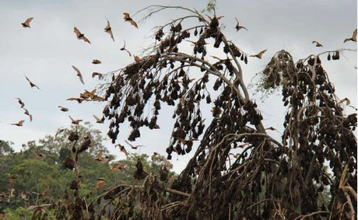
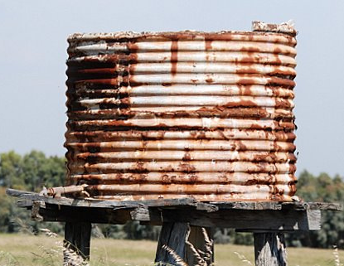
Aims
To Explore:
How best to construct network models as vector management tools?
What is the appropriate scale to model disease vector movement?
How does the ecology of the system influence the model development process?
Bat Camps
Flying-fox
Rainwater Tank
Aedes aegypti

Slide 3
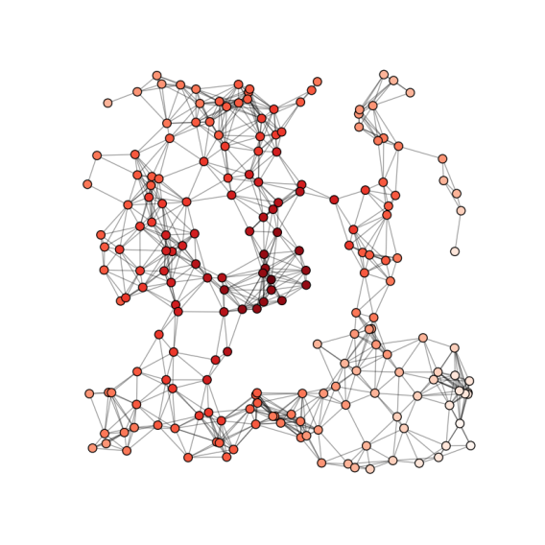
Nodes
Landscape Context:
Represent Metapopulations
Demographic Characteristics:
Disease transmission
Population growth rates
Spatially explicit location

Slide 4
Links or Edges
Landscape Context:
Flows of Information
Movement Characteristics:
Dispersal
Connectivity
Distance

Slide 5
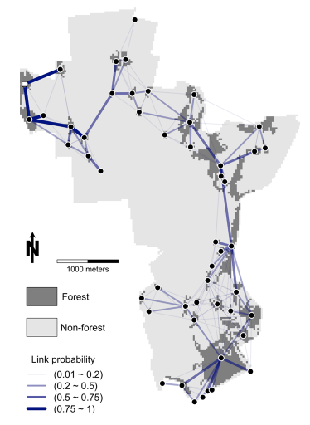
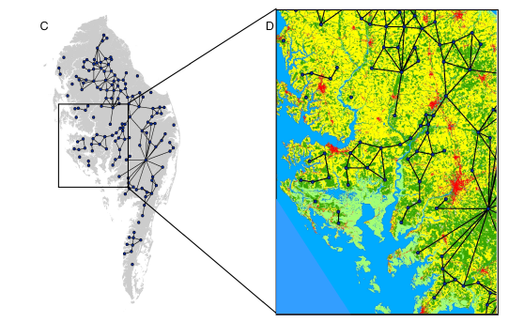
Spatially Explicit Networks
Quantify landscape connectivity
Identify pathways to invasion
Ferrari , Priesser and Fitzpatrick 2014
Lookingbill, Gardner, Ferrari and Keller 2010
Dynamic network
Spread of a forest pathogen
Identify habitat patches
Global Information Systems
Network simulation and analysis
Identify landscape connectivity

Slide 6
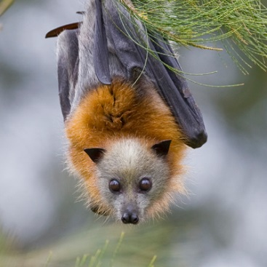
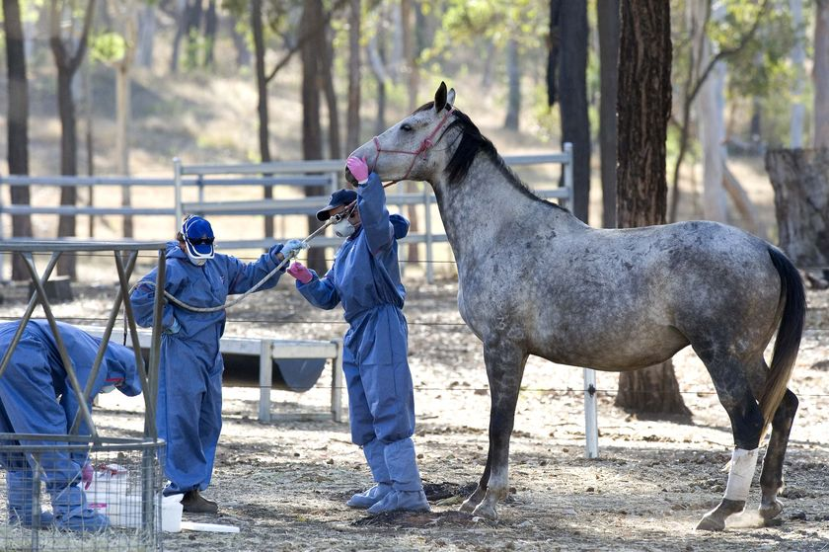
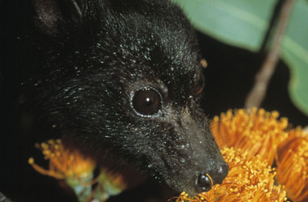
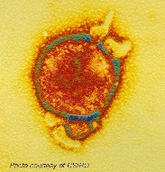
Flying Fox – Hendra virus
Grey Headed Flying Fox
Bat Camps
Spill over event
Black Flying Fox

Slide 7
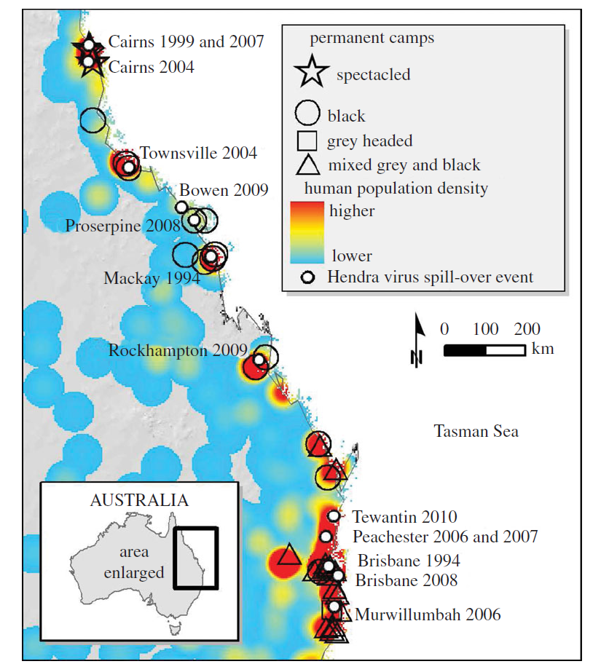
Urban habituation, ecological connectivity and epidemic dampening: the emergence of Hendra virus from flying foxes
Plowright, et al 2011

Slide 8
Nodes
Links
Populations with ongoing hendra transmission Highly seasonal location Uncertain location due to environment and climate
Flying-Fox
Aedes aegypti

Slide 9
Flying-Fox
Nodes
Links
Urban
Rural and urban populations
Rural

Slide 10
Flying-Fox
Nodes
Links
Rural and urban populations Does not explore: Foraging sites Spill over events
Spill Over Events

Slide 11
Flying-Fox
Nodes
Links
Rural and urban populations Does not explore: Foraging sites Spill over events | Distance between camps Probability of movement

Slide 12
Flying Fox
Nodes
Links
Rural and urban populations Does not explore: Foraging sites Spill over events | Distance between camps Probability of movement Don’t link with spill over events
In reality movement would be
represented by large numbers of links
and not solely measured by distance

Slide 13
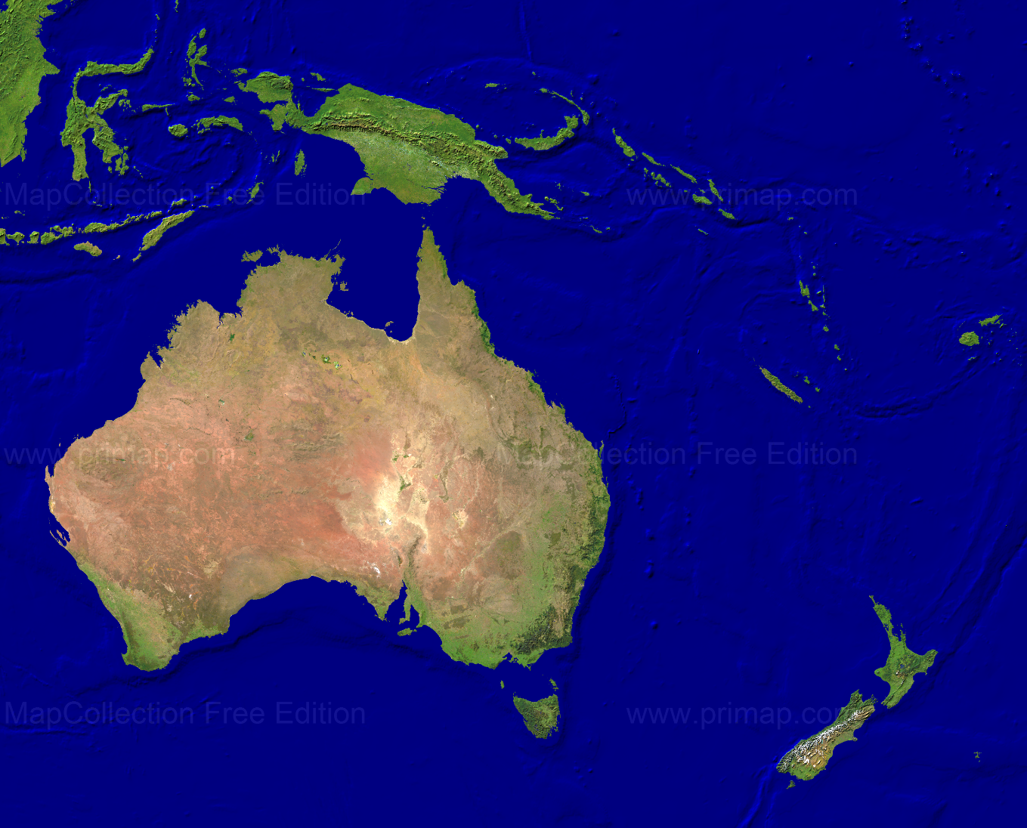
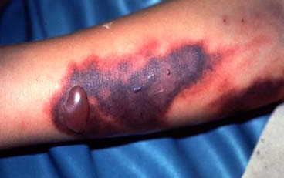
Aedes aegypti – Rainwater Tanks
Nouvelle-
Calédonie
Brisbane
Dengue fever

Slide 14
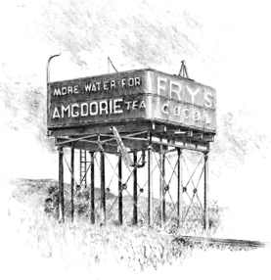
Aedes aegypti – Rainwater Tanks
Imported Cases - Brisbane
1911

Slide 15
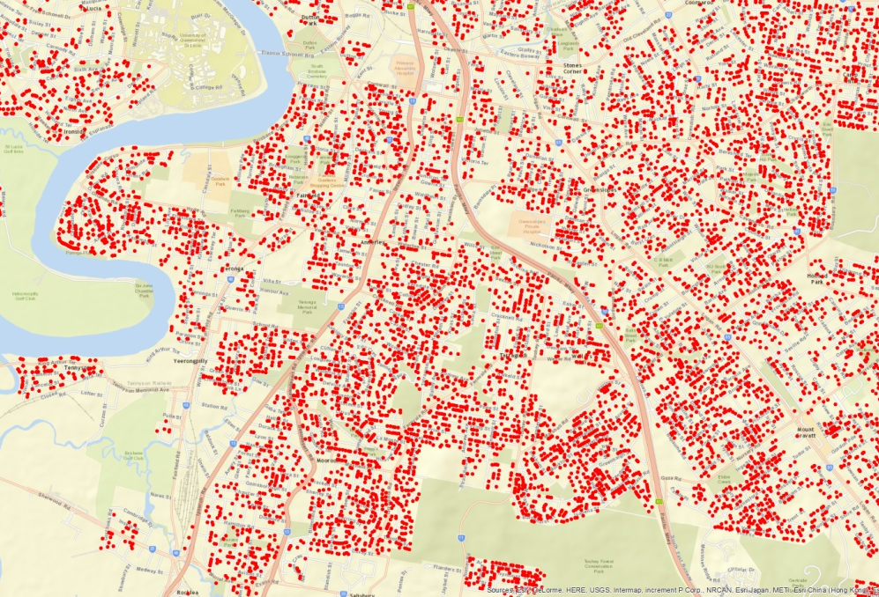
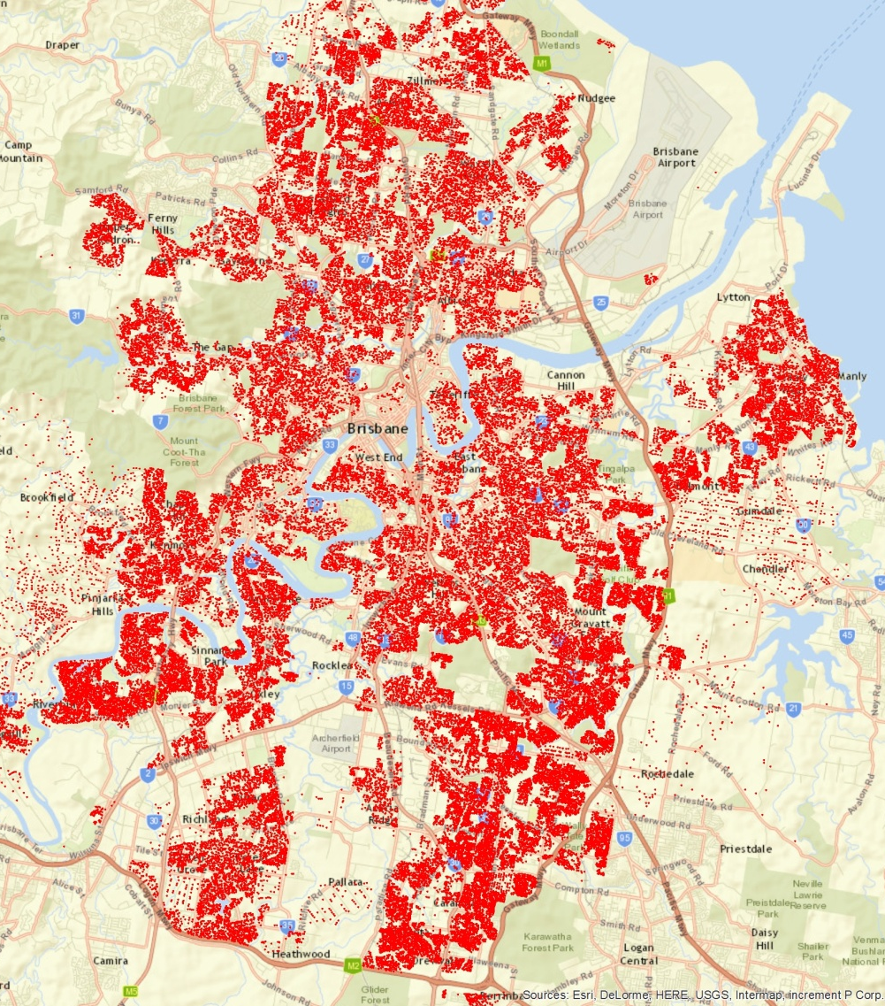
Brisbane
100,000 Rainwater Tanks

Slide 16
Nodes
Links
Populations with ongoing hendra transmission Highly seasonal location Uncertain location due to environment and climate | Distance between camps Probability of movement
Rainwater tanks Fixed and accurate spatial location Population growth rate Source or sink
Flying-Fox
Aedes aegypti

Slide 17
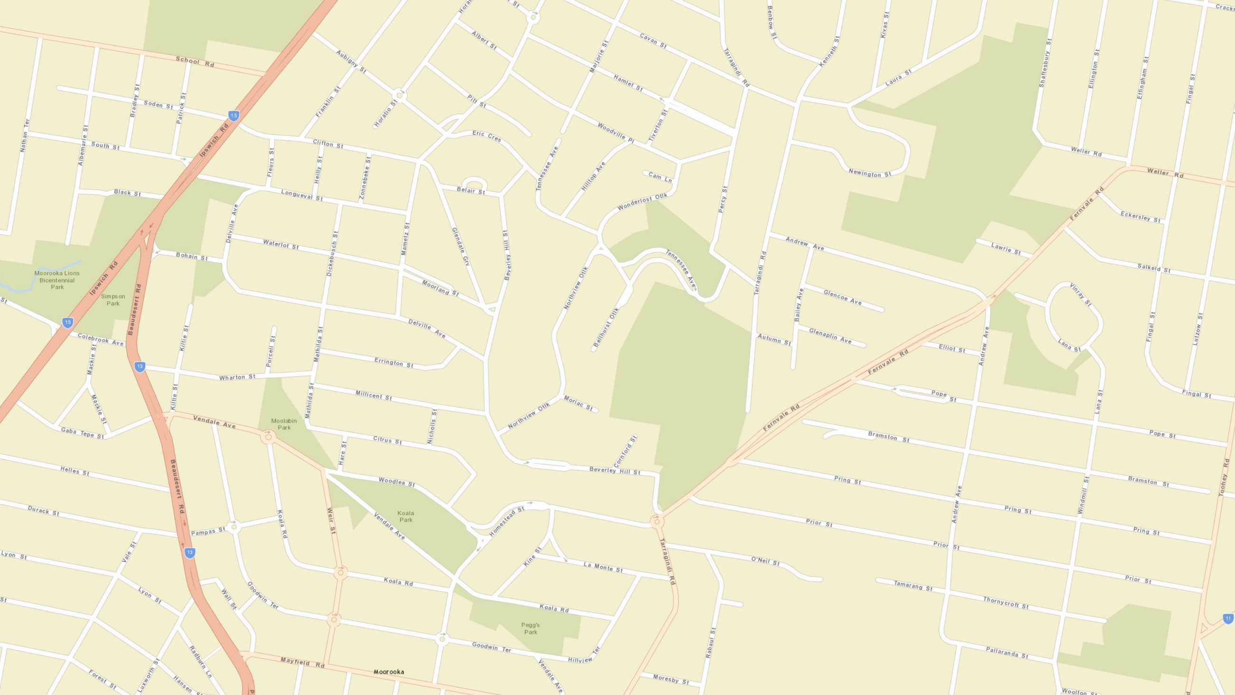
Street Map Layer
Data Type:
Street Address
0 200m

Slide 18
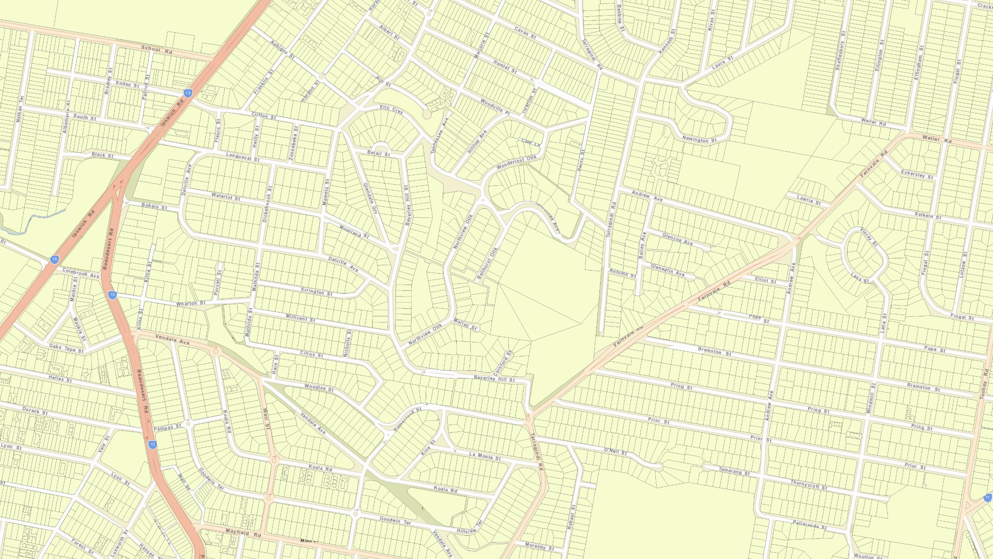
Cadastre Layer
Data Types:
Property, Block, Suburb, Local Government Areas (QLD Gov)
Socio-economic data (ABS)
0 200m

Slide 19
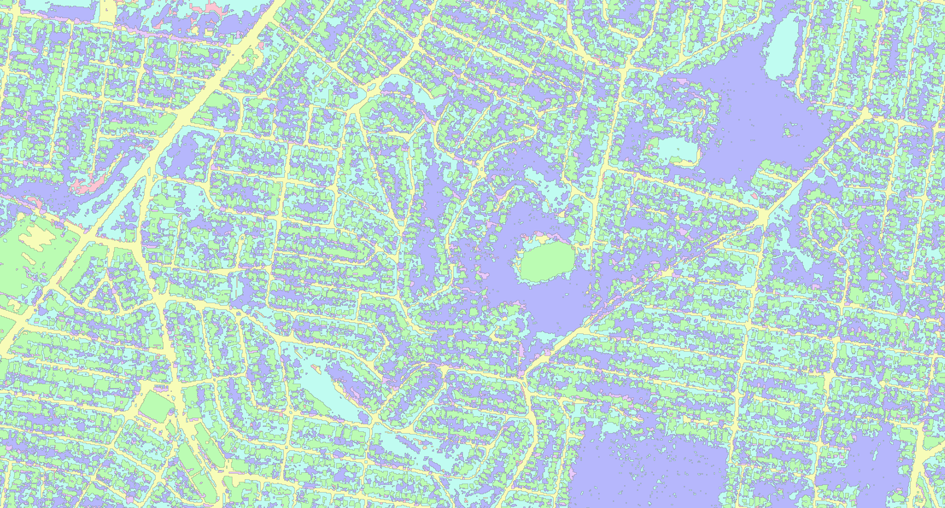
Landscape Cover Layer
Data Types:
Landscape Cover Raster (Brisbane City Council)
0 200m

Slide 20
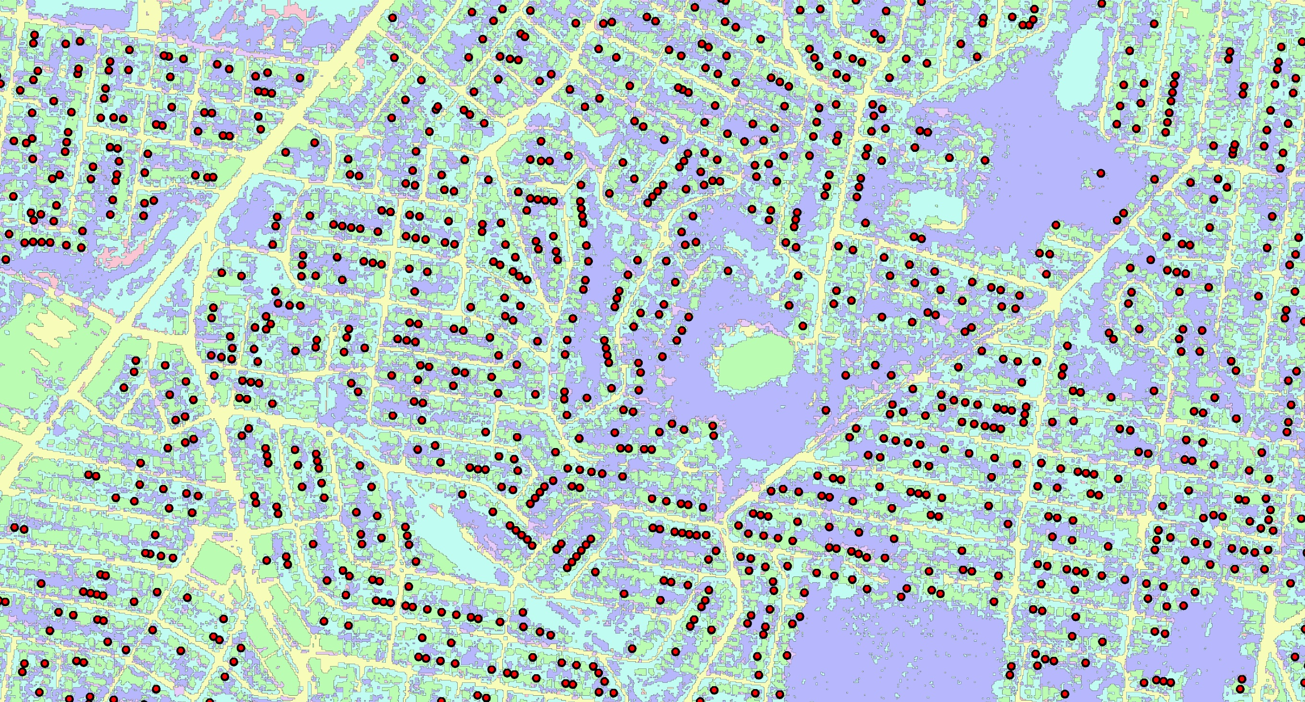
Tank Spatial Location
Data Types:
Landscape Cover Raster (Brisbane City Council)
Tank Location (BCC, QLD Gov)
0 200m

Slide 21
Nodes
Links
Populations with ongoing hendra transmission Highly seasonal location Uncertain location due to environment and climate | Distance between camps Probability of movement
Rainwater tanks Fixed and accurate spatial location Population growth rate Source or sink | Dispersal kernel Influence of population size Landscape influences probability of interaction
Flying-Fox
Aedes aegypti

Slide 22
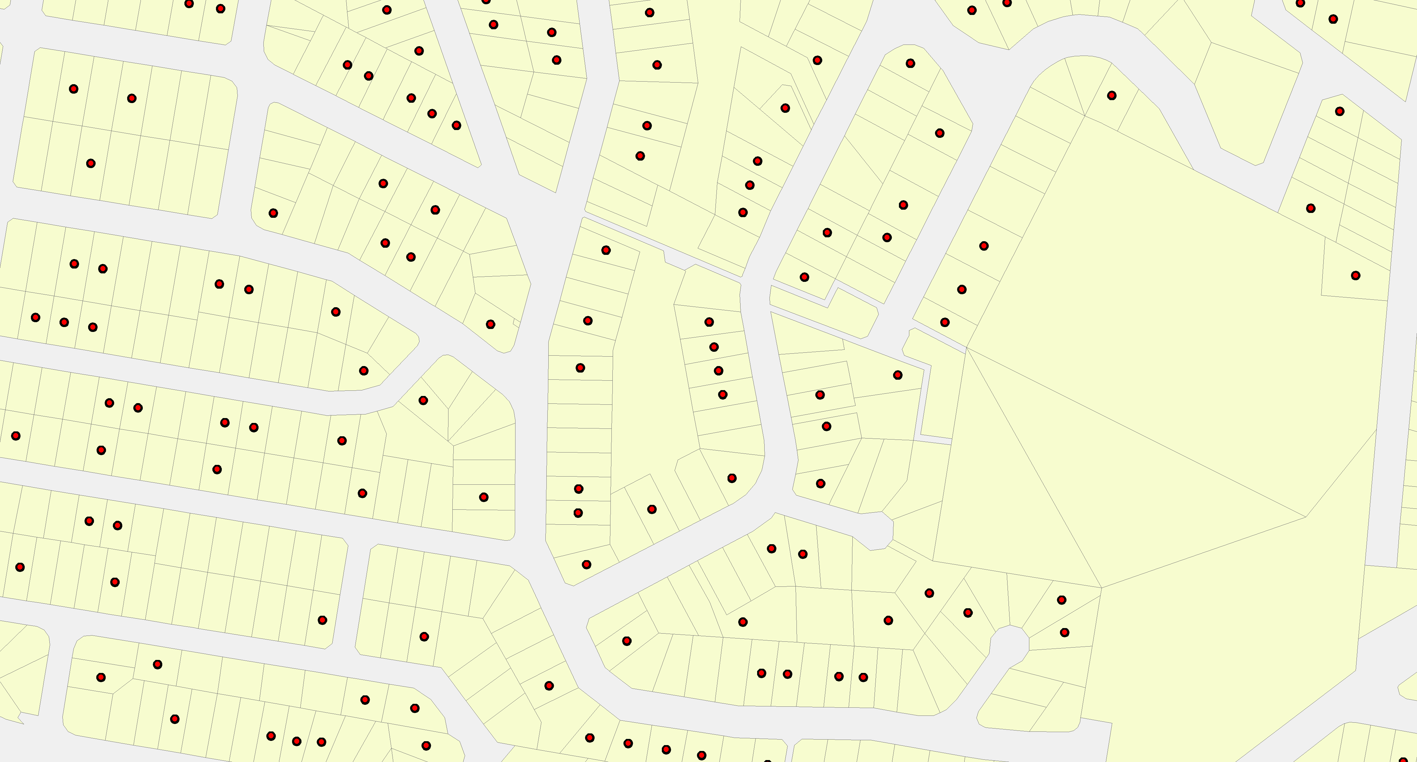
Sink
Source
Exposed

Slide 23
Sink
Source
Exposed

Slide 24
Network Analysis
Plowright, et al 2011
Node Influence:
Ability to target individual or groups of high risk nodes
Measure of centrality
Goal of vector management
Connectivity:
Scale not suitable for vector management
Does not include spill over sites or foraging sites
Hypothesis generating tool

Slide 25
Conclusions
Large contrasts between each network model relating to scale
Flying-fox model would benefit from additional scales and more dynamic nodes/links for management application
Mosquito model has a high resolution with plentiful data, which may be necessary to scale-up
Hypothesis generating tool vs management tool?

Slide 26
Thank you
Ecosciences/Biosecurity
Brendan Trewin, Hazel Parry, Myron Zalucki, David Westcott and Nancy Schellhorn
The Challenges of Developing Spatially Explicit Network Models for the Management of Disease Vectors in Ecological Systems
e brendan.trewin@csiro.au
w http://www.csiro.au/Organisation-Structure/Divisions/Ecosystem-Sciences
Ecosystem services / Biosecurity flagship
INRM Scholarship

